Slide 1
An MRI-based Predictive Marker for Alzheimer’s Disease in Asymptomatic Individuals
Qinyuan Sun
12/8/2014

Slide 2
Background
Pathological manifestations of Alzheimer's disease begin many years before the patient can be diagnosed by cognitive tests
Exploiting advanced imaging-based techniques to characterize prominent neurodegenerative patterns during the prodromal stages of the disease is promising

Slide 3
Motivation
Identify people who are cognitively-normal but at increased risk of Alzheimer's disease as early as possible.
Use routine MRI protocols as primary source of information to develop an easy-to-use, easy-to-calculate, aggregate abnormality score.

Slide 4
Support Vector Machine
A support vector machine (SVM) learns a hyper-plane as a decision boundary in high dimensional kernel space that separates positive and negative samples
Can be cast as an optimization problem and solved efficiently

Slide 5


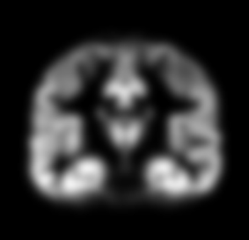

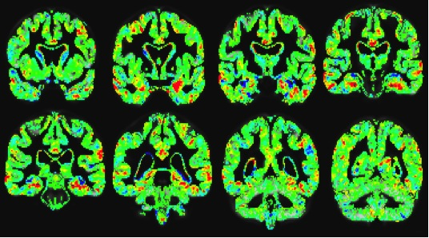


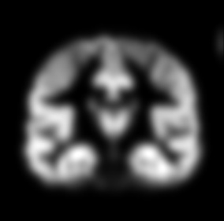



Training Phase
Group 1 (e.g., Healthy Control)
Classification
Function
Support Vector Machine
Subject 1
Subject 2
Subject 3
Subject N
Group 2 (e.g., AD Dementia)
Subject 1
Subject 2
Subject 3
Subject N
Testing Phase
New subject
Classification Function
From Training Phase
New subject assigned to Group 1 or 2

Slide 6
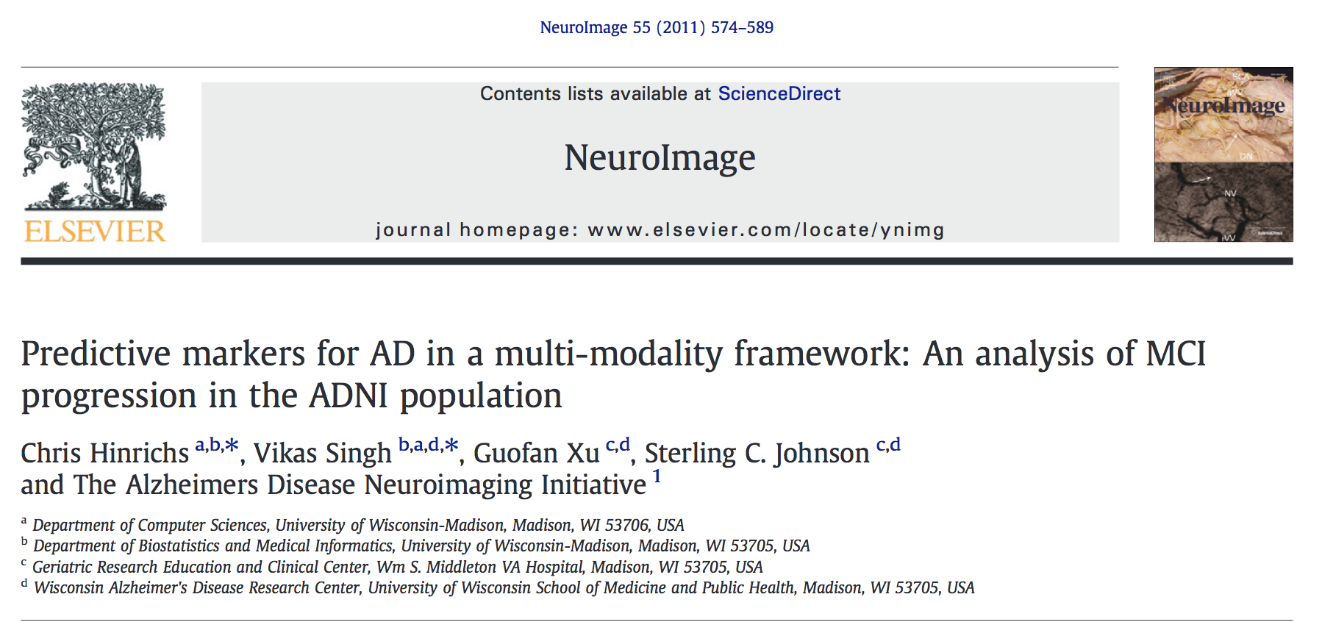
Multiple Kernel Learning
Multiple Kernel Learning (MKL) methods aim to construct a kernel model where the kernel is a linear combination of fixed base kernels.
MKL coupled with SVM achieved great success in predicting progression of MCI to AD

Slide 7
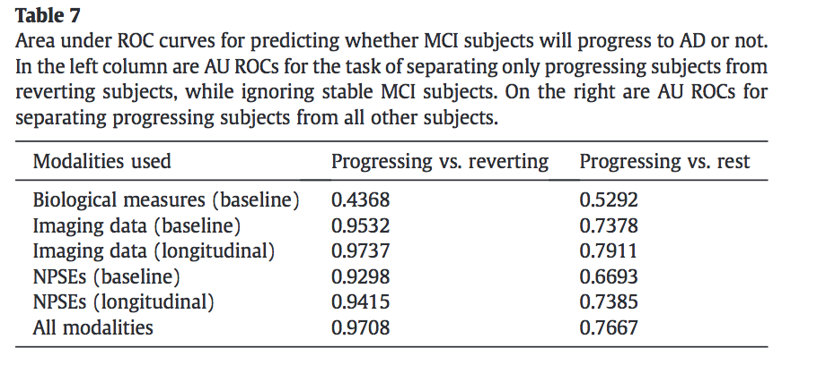
Success of MKL
Predicting Progression of MCI to AD
A Multi-Modality Disease Marker (MMDM) is proposed. Both MRI T1 and PET-FDG images are used

Slide 8
Single Modality Disease Marker
Drawback of MMDM is that PET-FDG scan is used and not easily accessible
A single modality disease marker (SMDM) that utilizes only T1 MRI is desirable
SMDM is derived as margin of testing sample from decision boundary learned by SVM

Slide 9
Image Data
Training T1 Image Data
225 CN and 182 AD from ADNI-1
Testing T1 Image Data
385 MCI from ADNI-1
170 subjects from PDT
137 subjects from MRT
189 subjects from IMPACT
38 subjects from PIPR

Slide 10
Demographic characteristics of Participants
Group | Number of Subjects | Age (mean ± std) | Gender (M/F) | Education (mean ± std) | APOE Carrier (Non/Any) | Family History (Pos/Neg)
AD | 182 | 75.38 ± 7.54 | 94/88 | 14.81 ± 3.10 | 62/120 | 74/106
MCI | 385 | 74.77 ± 7.42 | 248/137 | 15.71 ± 2.98 | 178/207 | 161/222
CN | 225 | 75.94 ± 5.00 | 116/109 | 16.02 ± 2.86 | 165/60 | 96/126
Asymptomatic | 534 | 59.24 ± 6.45 | 169/375 | 16.10 ± 2.38 | 320/224 | 412/132
There are 7 subjects in ADNI-1 lack family history

Slide 11
Pipeline
Preprocessing
Tissue segmentation and normalization to MNI
Support Vector Machine
Each base kernel is computed using a varying number of voxel-wise features
One final kernel is constructed by averaging and normalizing the base kernels.
An SVM is trained with the final kernel
SMDM is derived from SVM
Healthier subjects have higher SMDM score

Slide 12
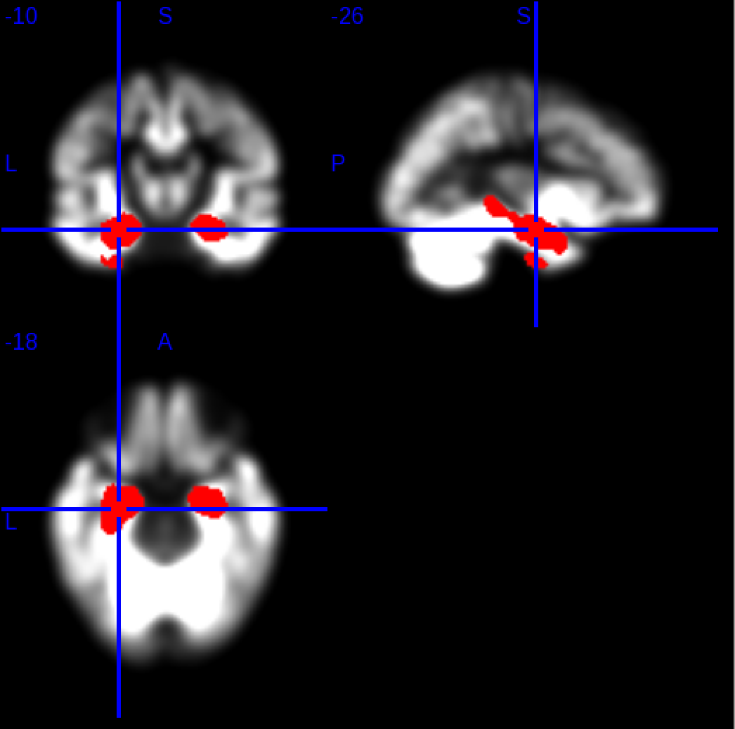
Top 5000 Voxel

Slide 13
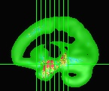
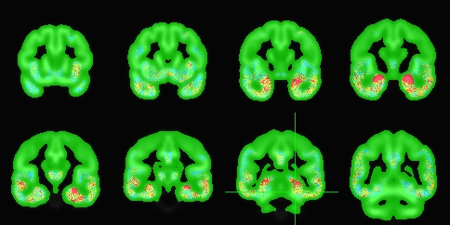
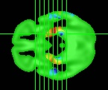
SVM Weights
Image intensity in voxels showing a red color contributes to a subject's healthy (positive) diagnosis, while intensity in voxels showing a blue color contributes to a subject's diseased (negative) diagnosis, and intensity in green-colored voxels is essentially ignored.

Slide 14
Does SMDM predict progression to AD in persons with MCI?

Slide 15
Multivariable Cox Regression in MCI:
Progression to AD Dementia over 36 Months
Variable | β | SE | Wald χ² | HR(95% C.I.) | P Value
SMDM | -.43 | .11 | 14.78 | .65(.53,.81) | <0.001
CSF Aβ42 | -.01 | .01 | .76 | .99(.67,1.01) | .382
APOE4 | .19 | .30 | .39 | 1.20(.67,2.16) | .534
RAVLT Long Delay | -.13 | .06 | 4.08 | .88(.78,.99) | .043
CDR Sum of Boxes | .24 | .12 | 3.86 | 1.28(1.00,1.62) | .049
Adjusted for age, sex, and education

Slide 16
Does SMDM predict AD risk in asymptomatic individuals?

Slide 17
Correlation of SMDM and memory performance
 | AVLT Total | AVLT Short Delay | AVLT Long Delay | AVLT Recognition
Correlation | 0.236 | 0.296 | 0.265 | 0.226
P value | 6.64E-07 | 3.46E-10 | 2.20E-08 | 2.12E-06

Slide 18
Correlation of SMDM and CSF biomarkers
 | Abeta42 | Ptau | Ttau | Ptau/Abeta42 | Ttau/Abeta42 | MCP1 | YKL40 | NFL
Correlation | -0.145 | 0.034 | -0.047 | 0.081 | 0.016 | -0.045 | -0.019 | -0.194
P Value | 0.038 | 0.634 | 0.509 | 0.251 | 0.820 | 0.515 | 0.787 | 0.005

Slide 19
Decomposing the unexpected CSF findings

Slide 20
Relationship between CSF biomarkers and AVLT
AVLT Total | Abeta42 | Ptau | Ttau | Ptau/Abeta42 | Ttau/Abeta42 | MCP1 | YKL40 | NFL
Correlation | -0.057 | -0.101 | -0.088 | -0.005 | -0.013 | 0.002 | -0.154 | -0.183
P Value | 0.413 | 0.148 | 0.206 | -.944 | 0.858 | 0.980 | 0.026 | 0.008
AVLT Short Delay | Abeta42 | Ptau | Ttau | Ptau/Abeta42 | Ttau/Abeta42 | MCP1 | YKL40 | NFL
Correlation | -0.109 | -0.123 | -0.121 | 0.029 | 0.006 | 0.026 | -0.119 | -0.220
P Value | 0.116 | 0.078 | 0.083 | 0.678 | 0.929 | 0.710 | 0.086 | 0.001
AVLT Long Delay | Abeta42 | Ptau | Ttau | Ptau/Abeta42 | Ttau/Abeta42 | MCP1 | YKL40 | NFL
Correlation | -0.059 | -0.056 | -0.079 | 0.031 | -0.006 | 0.009 | -0.068 | -0.211
P Value | 0.398 | 0.421 | 0.258 | 0.660 | 0.932 | 0.892 | 0.325 | 0.002
AVLT Recognition | Abeta42 | Ptau | Ttau | Ptau/Abeta42 | Ttau/Abeta42 | MCP1 | YKL40 | NFL
Correlation | -0.098 | -0.018 | -0.008 | 0.079 | 0.068 | 0.055 | -0.043 | -0.073
P Value | 0.157 | 0.797 | 0.904 | 0.261 | 0.330 | 0.433 | 0.533 | 0.293

Slide 21
Notes:
On CSF Abeta, Stable vs. Decliner, p=.033; Stable vs. MCI, p=.038; Decliner vs. MCI, p=.002.
On Precuneus PiB, Stable vs. Decliner, p=.661; Stable vs. MCI, p<.001; Decliner vs. MCI, p<.001.

Slide 22
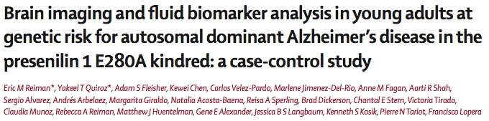
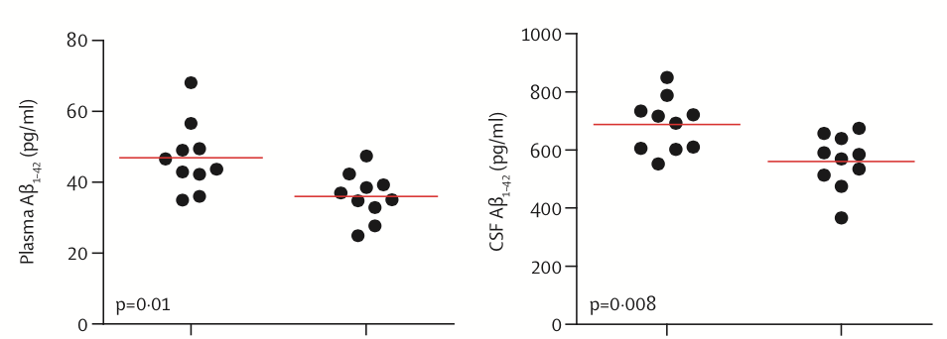
Lancet Neurology, 2012
Carriers
Non-carriers
Carriers
Non-carriers

Slide 23
SMDM vs CSF: the smackdown

Slide 24
Model:
AVLT_total = β₁SMDM + β₂Sex + β₃Age + β₄Education + β₅FH + β₆APOE + β₇CSF Biomarker
 | Abeta42 | Ptau | Ttau | Ptau/Abeta42 | Ttau/Abeta42 | MCP1 | YKL40 | NFL
SMDM | 0.159 (0.018) | 0.154 (0.018) | 0.148 (0.022) | 0.148 (0.022) | 0.146 (0.023) | 0.157 (0.015) | 0.160 (0.014) | 0.151 (0.020)
Sex | 0.350 (<0.001) | 0.354 (<0.001) | 0.354 (<0.001) | 0.351 (<0.001) | 0.354 (<0.001) | 0.341 (<0.001) | 0.335 (<0.001) | 0.344 (<0.001)
Age | -0.236 (<0.001) | -0.229 (0.001) | -0.240 (<0.001) | -0.247 (<0.001) | -0.248 (<0.001) | -0.245 (<0.001) | -0.219 (0.002) | -0.230 (0.001)
Education | 0.151 (0.019) | 0.141 (0.027) | 0.149 (0.020) | 0.140 (0.029) | 0.146 (0.022) | 0.125 (0.054) | 0.132 (0.040) | 0.153 (0.017)
FH | -0.120 (0.061) | -1.09 (0.086) | -0.113 (0.078) | -0.114 (0.073) | -0.115 ( 0.070) | -0.121 (0.059) | -0.112 (0.081) | -0.119 (0.063)
APOE | -0.004 (0.950) | 0.001 (0.993) | 0.000 (0.997) | -0.001 (0.991) | -0.006 (0.927) | -0.008 (0.893) | -0.007 (0.905) | -0.002 (0.975)
CSF | -0.015 (0.817) | -0.046 (0.478) | 0.003 (0.959) | 0.010 (0.881) | 0.036 (0.577) | 0.062 (0.330) | -0.055 (0.404) | -0.030 (0.647)

Slide 25
Spatial distribution of SMDM association with AD brain biomarkers

Slide 26
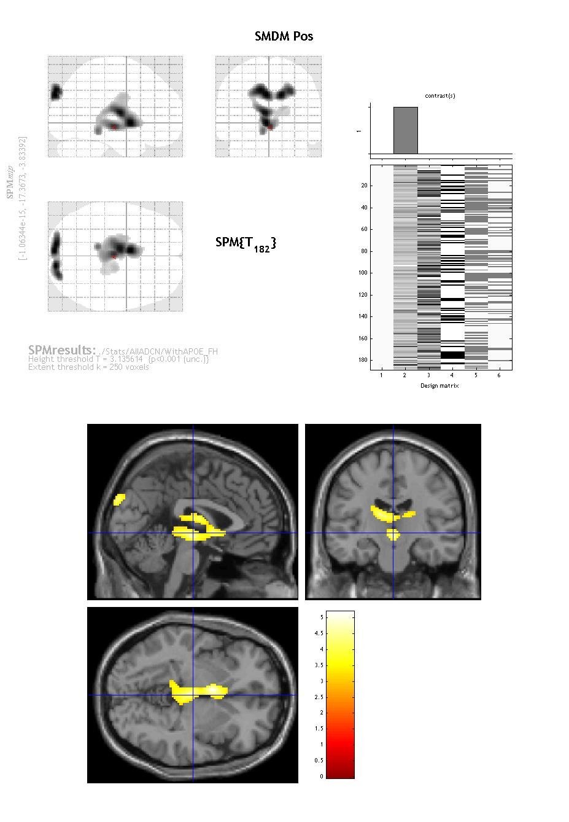
PiB voxel-wise analysis
188 subjects
Adjusted for age, gender, family history and APOE
P voxel < 0.001
Cluster extent = 250
No significance found

Slide 27
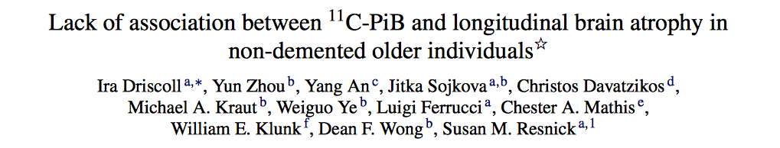
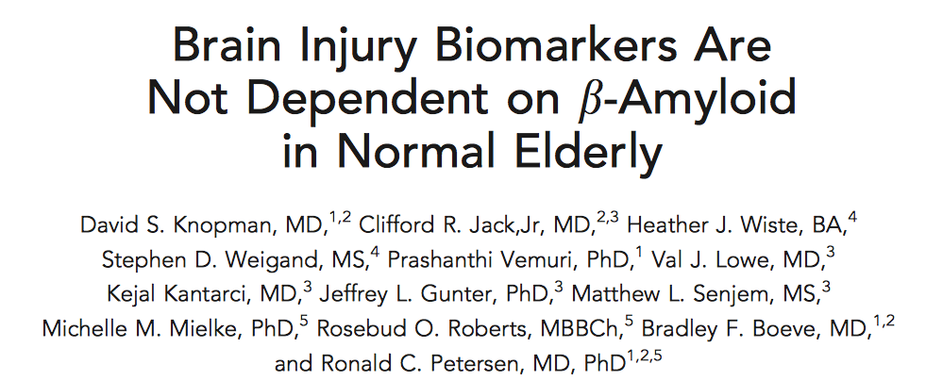
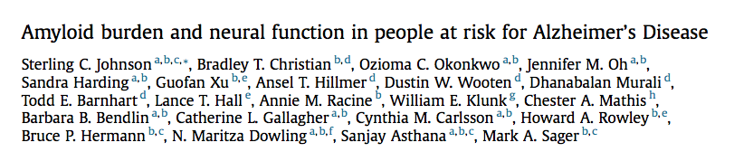
Neurobiology of Aging, 2011
Annals of Neurology, 2013
Neurobiology of Aging, 2014

Slide 28
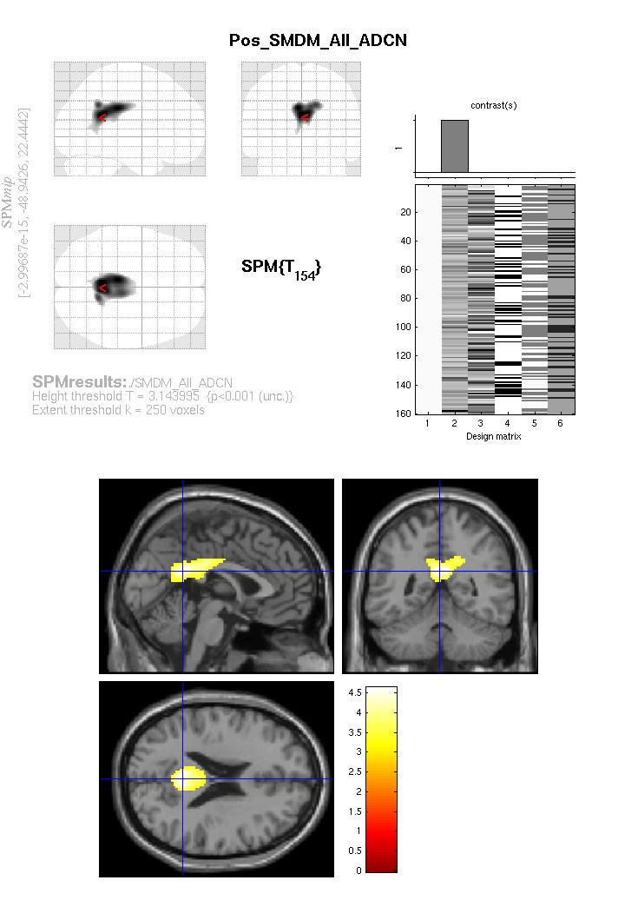
FDG voxel-wise analysis
160 subjects
Adjusted for age, gender, family history and APOE
P voxel < 0.001
Cluster extent = 250
Localized finding in the posterior cingulate

Slide 29
Is SMDM simply a fancy term for hippocampal volume?

Slide 30
Top 5000 Voxel

Slide 31
Model:
AVLT= β₁SMDM + β₂Sex + β₃Age + β₄Education + β₅FH + β₆APOE + β₇HippoVol + β₈ICV
 | AVLT Total | AVLT Short Delay | AVLT Long Delay | AVLT Recognition
SMDM | 0.187 (<0.001) | 0.250 (<0.001) | 0.206 (<0.001) | 0.178 (<0.001)
Sex | 0.344 (<0.001) | 0.248 (<0.001) | 0.252 (<0.001) | 0.178 (<0.001)
Age | -0.140 (0.001) | -0.125 (0.003) | -0.101 (0.018) | -0.025 (0.582)
Education | 0.169 (<0.001) | 0.134 (0.001) | 0.154 (<0.001) | 0.057 (0.178)
FH | -0.049 (0.228) | -0.057 (0.168) | -0.087 (0.033) | 0.014 (0.739)
APOE | -0.001 (0.982) | -0.026 (0.525) | -0.023 (0.574) | -0.072 (0.094)
Hippocampal Volume | -0.002 (0.970) | -0.044 (0.374) | -0.006 (-0.910) | 0.099 (0.058)
ICV | -0.001 (0.984) | -0.020 (0.748) | -0.089 (0.154) | -0.085 (0.196)

Slide 32
Conclusion
SMDM as an image marker to estimate the risk of Alzheimer’s Disease
In MCI
Outperforms widely-used makers of risk for AD in Cox regression
In asymptomatic adults
Has good correlation with memory score
Has stronger correlation with memory score compared with CSF measures
Shows focal correlation with posterior cingulate metabolism in FDG voxel-wise analysis
Is not simply a repackaging of hippocampal volume

Slide 33
Future Work
Apply SMDM to predict decline in memory scores in asymptomatic group
Optimize SMDM
Use CSF information—as proxy for neuropathology—to preselect training sample
Train with only AD cases who have CSF signature for AD and controls who lack CSF signature for AD

